Slide 1
Baltic AID
Fundraising
Romet Mägar, Roman Wróblewski, Agata Solecka

Slide 2
PUBLIC FUNDING
Application Forms
Content Description
Applicant Description
Purpose for Application - Describe the importance for all stakeholders in the project
How does the financing help to achieve your goals?
Analyse the commercial value of your product.
Short Description of Project - Describe the nature of the project
Where and when is the project taking place?
Why is this project important for the audience?
What is the potential cultural impact of this work?
Communication and Marketing Plan
How do you intend to inform the public?
How do you plan to reach out to your target groups?
Schedule
Partners
Estimated Budget
Be sure to attach all the relevant quotations to justify each cost.

Slide 3
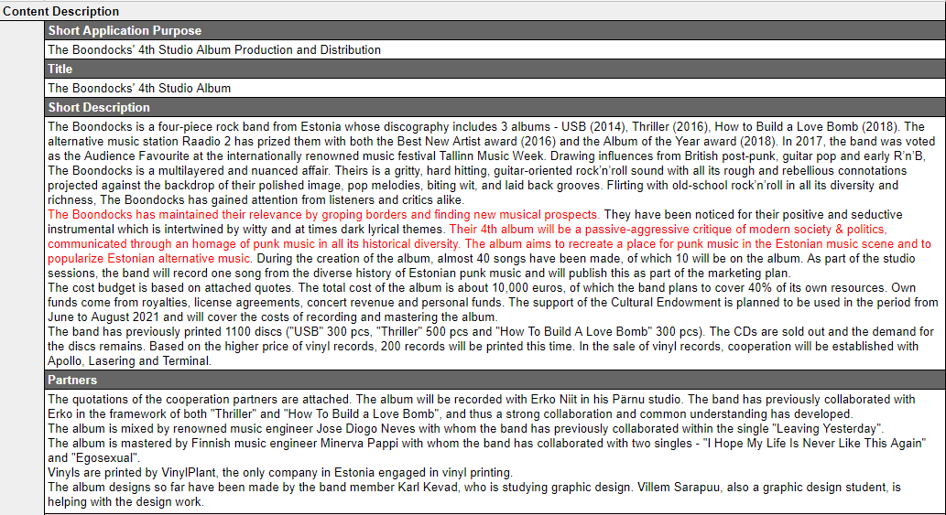
PUBLIC FUNDING
Content Description

Slide 4
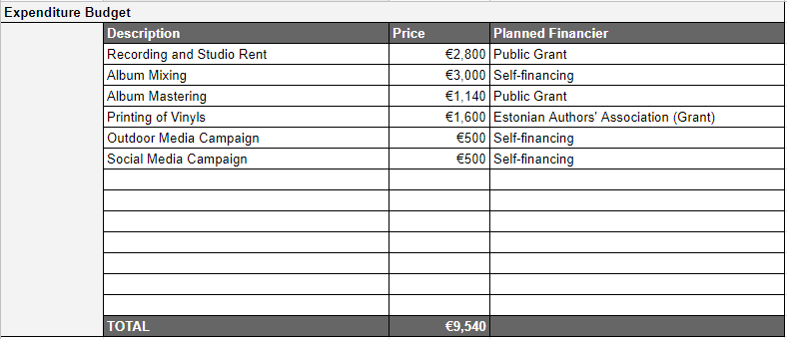
PUBLIC FUNDING
Estimated Budget

Slide 5
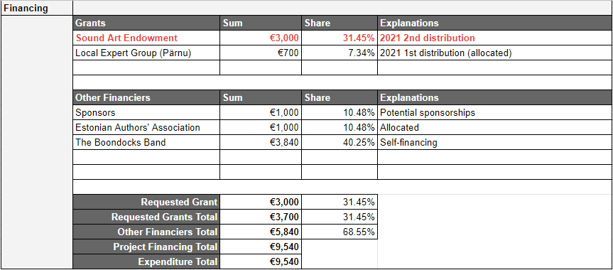
PUBLIC FUNDING
Estimated Financing

Slide 6
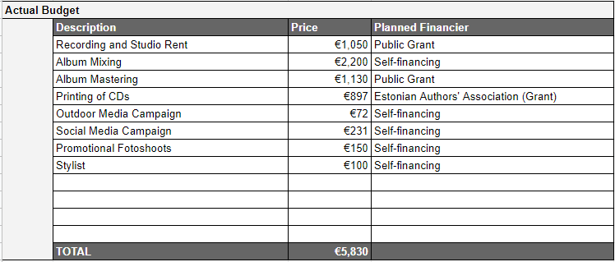
PUBLIC FUNDING
Actual Budget

Slide 7
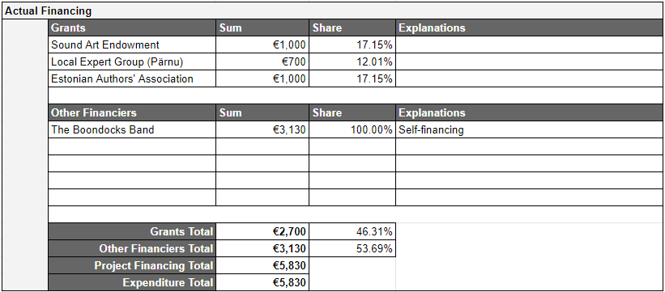
PUBLIC FUNDING
Actual Financing

Slide 8
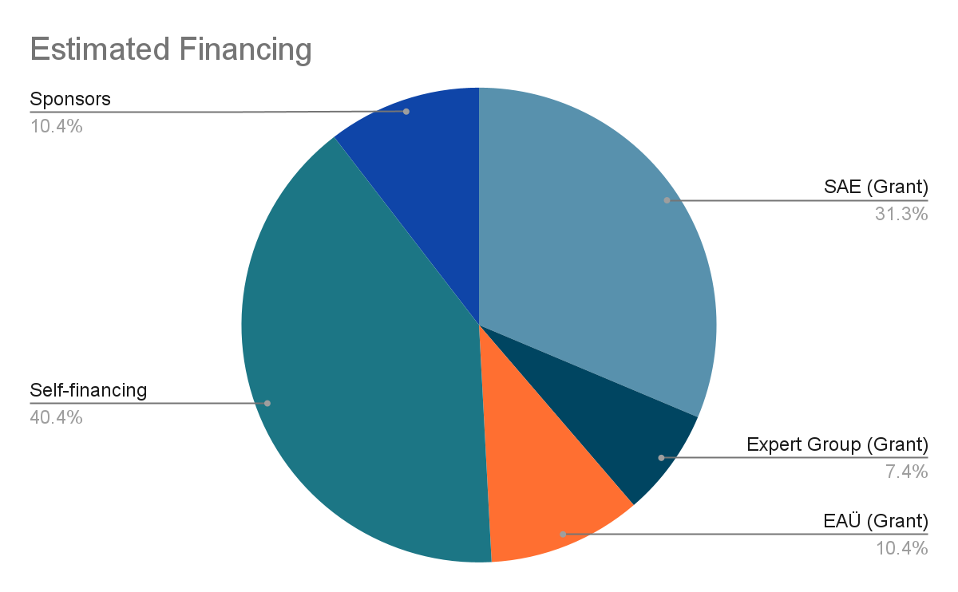
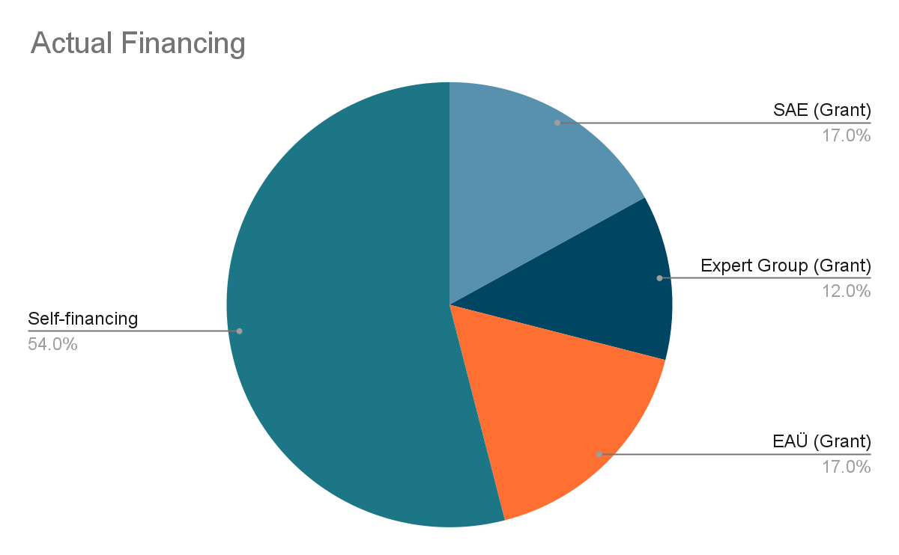
PUBLIC FUNDING
Budget Comparison

Slide 9
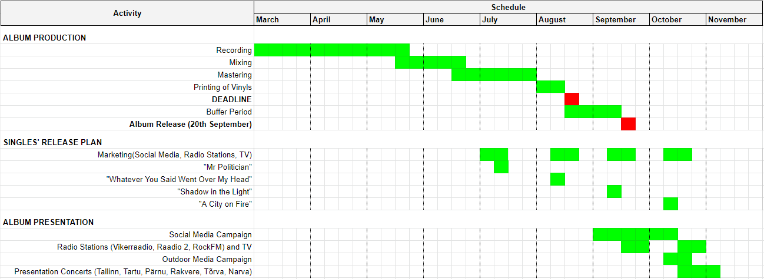
PUBLIC FUNDING
Schedule

Slide 10
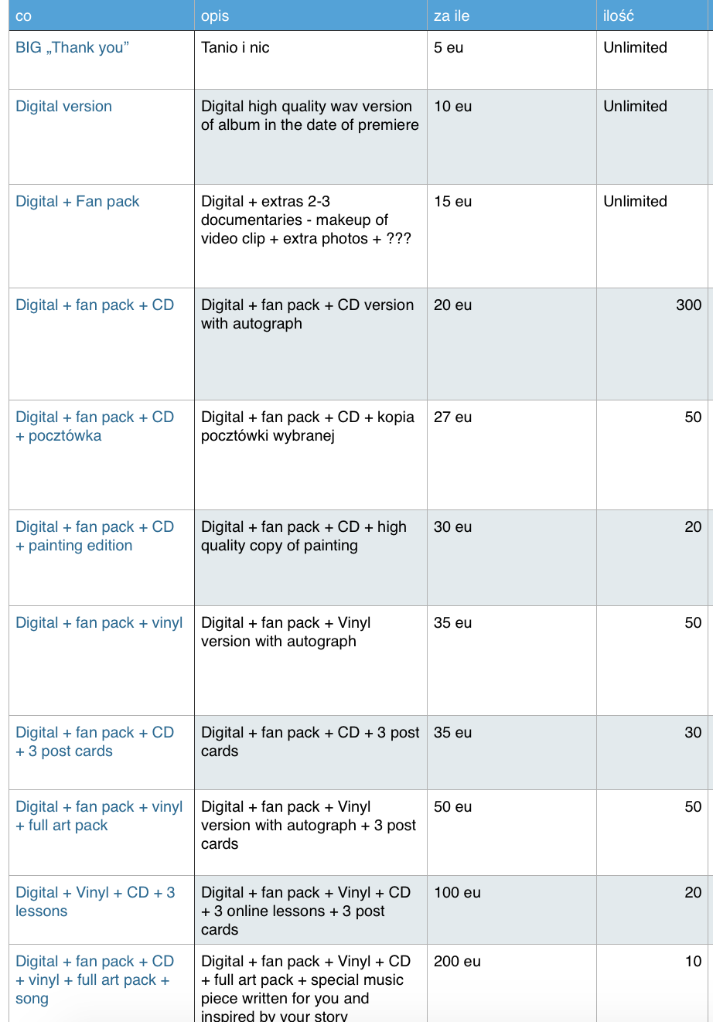
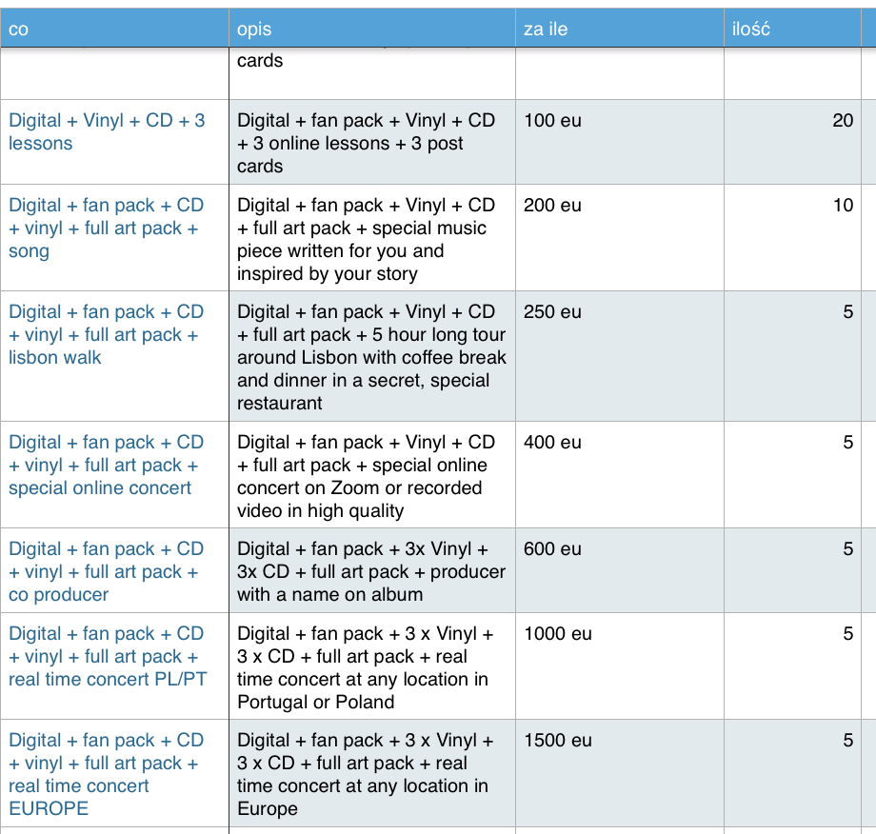
CROWDFUNDING
Preparation part 1 - full list of perks
5

Slide 11
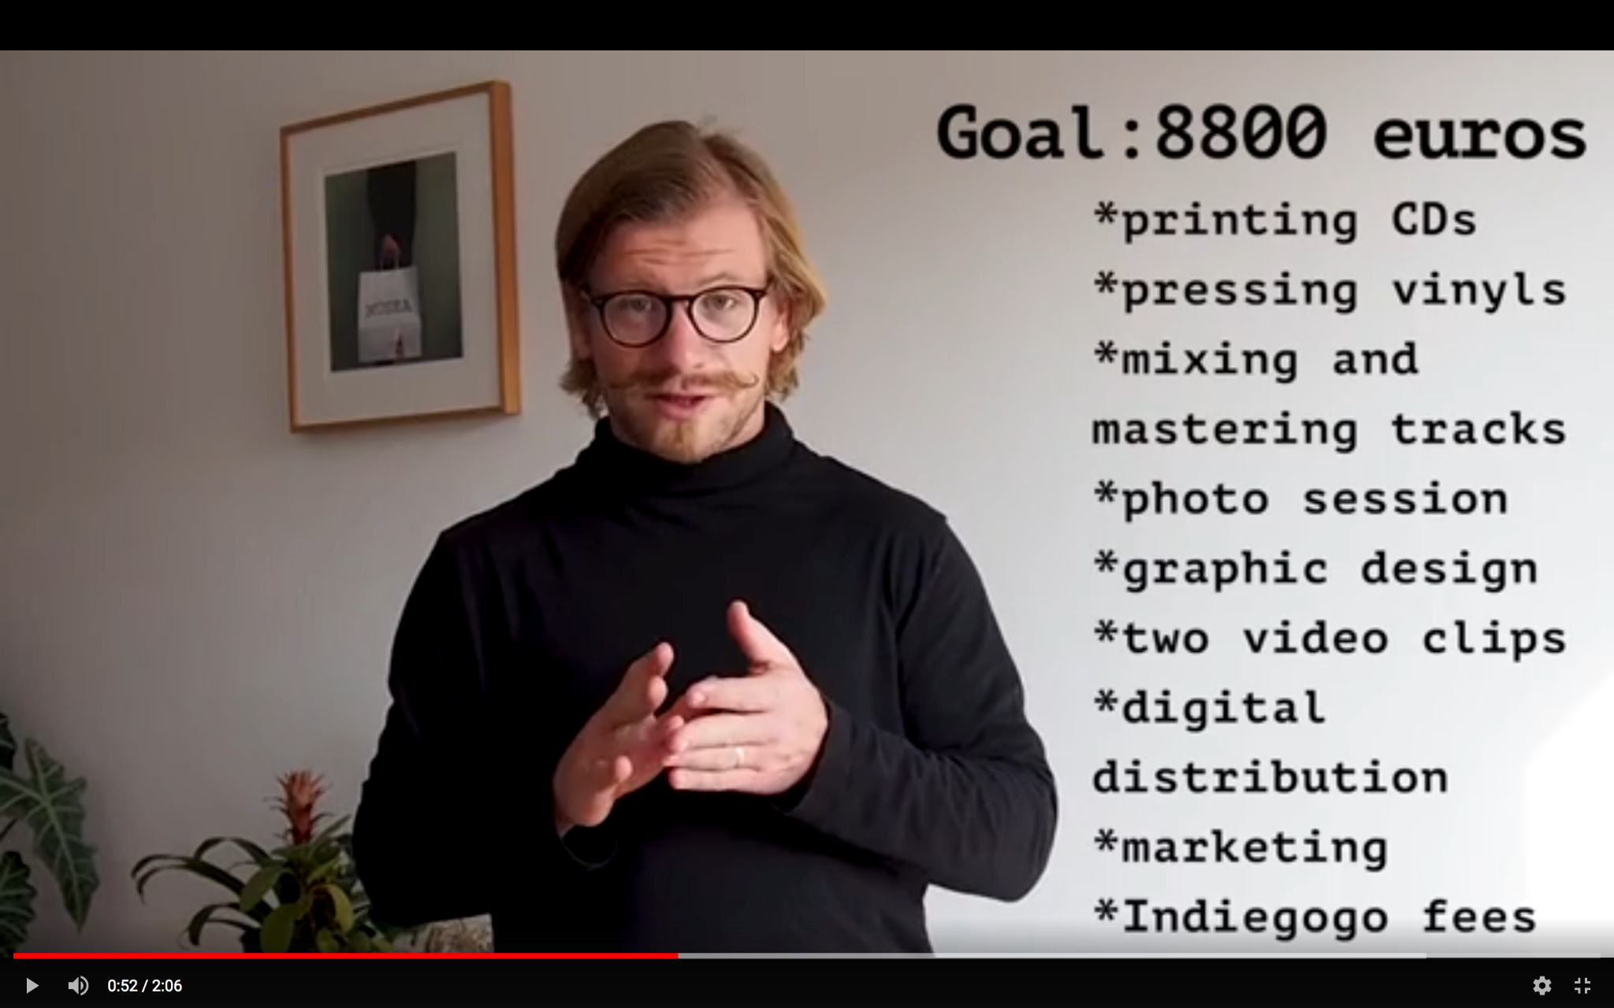
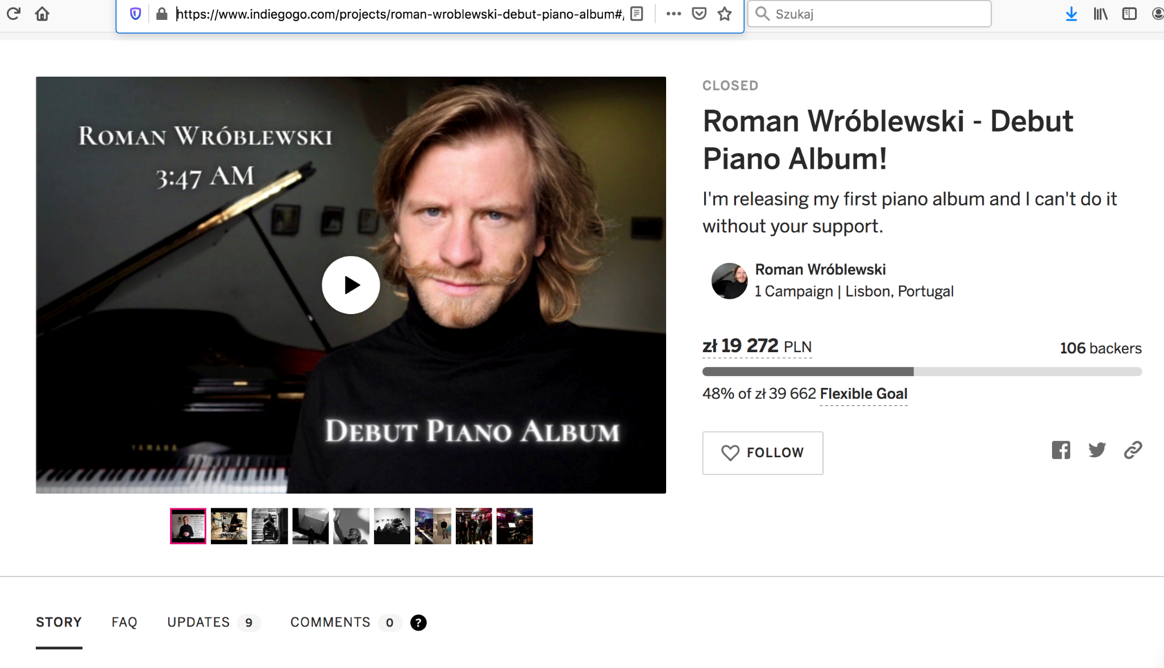
CROWDFUNDING
Preparation part 2 - visual content
Pitch Video perks/fb post/graphics

Slide 12
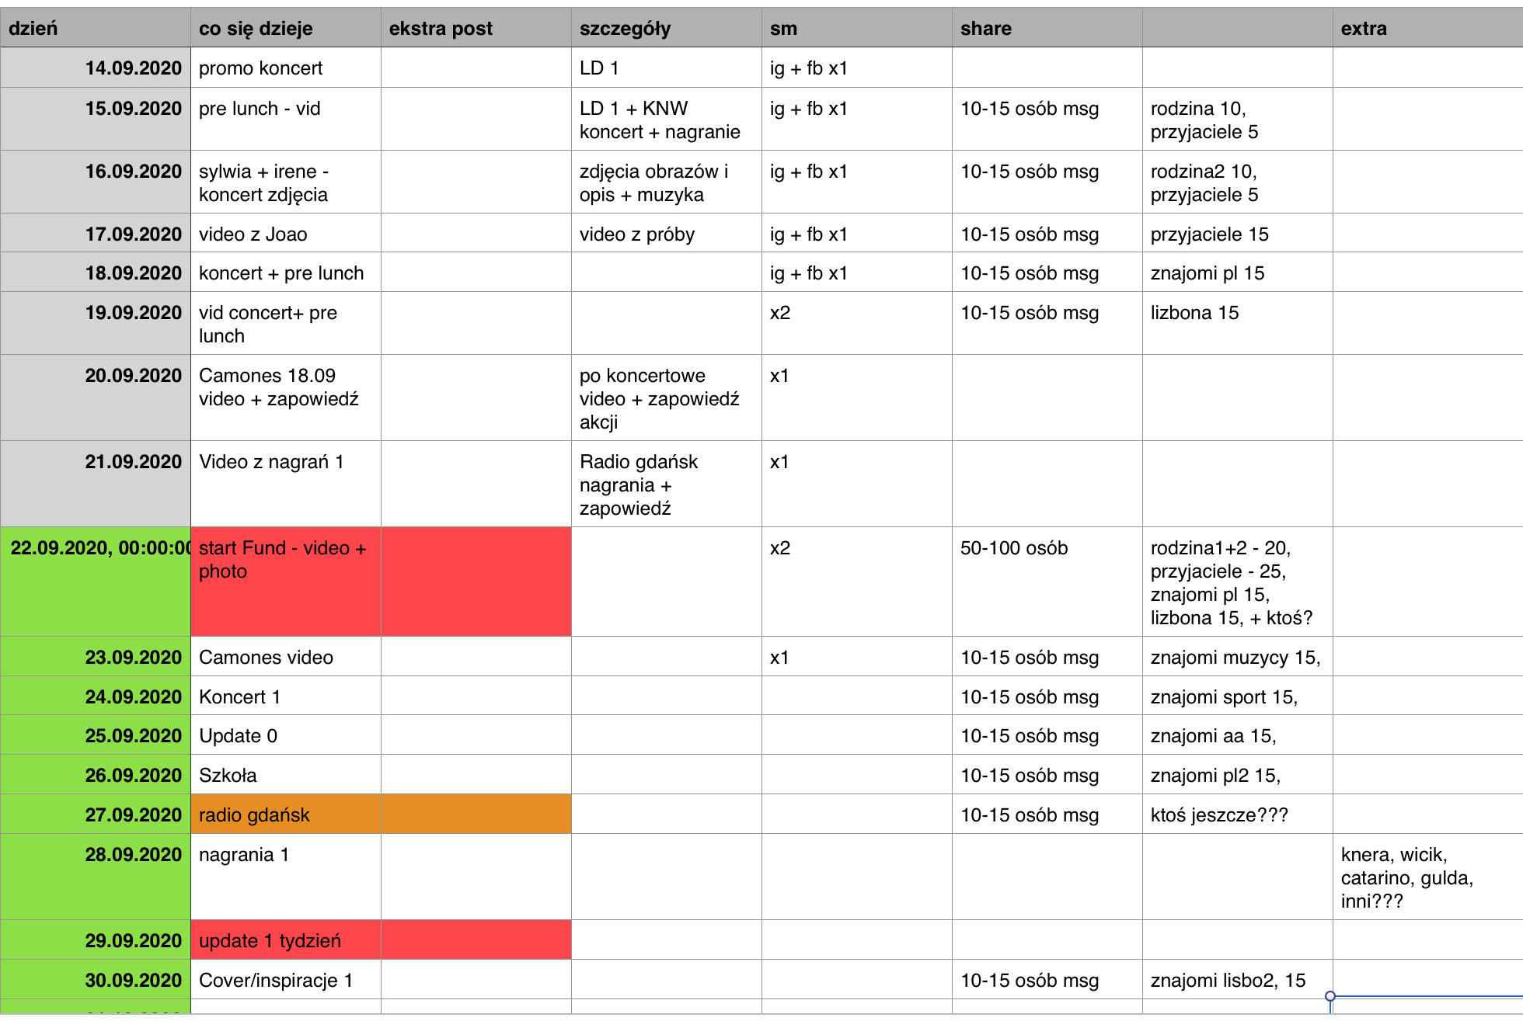
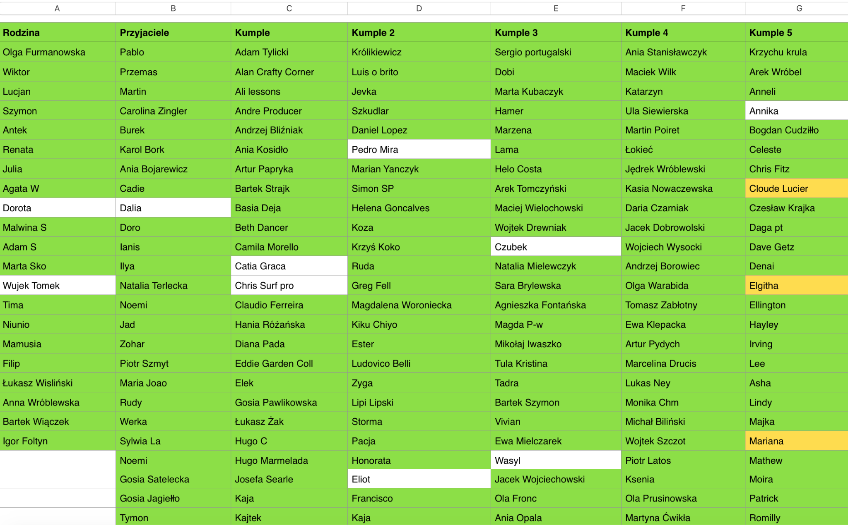
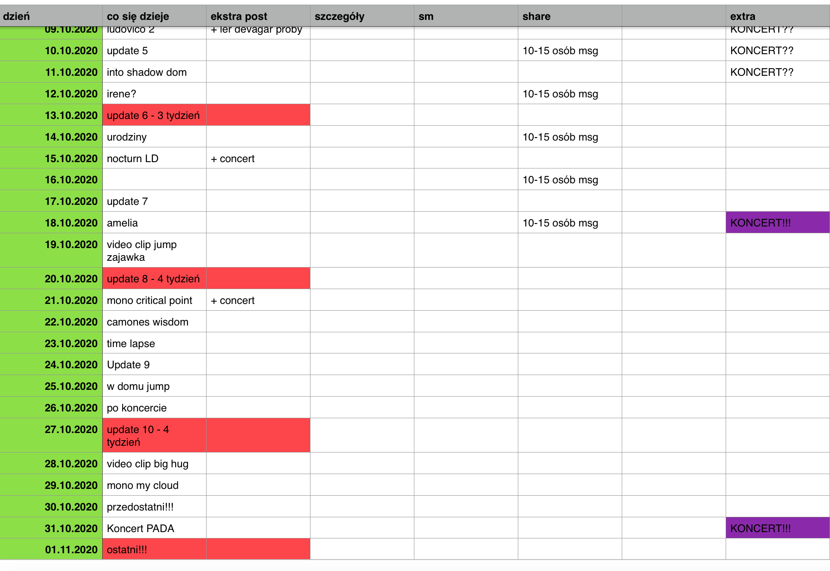
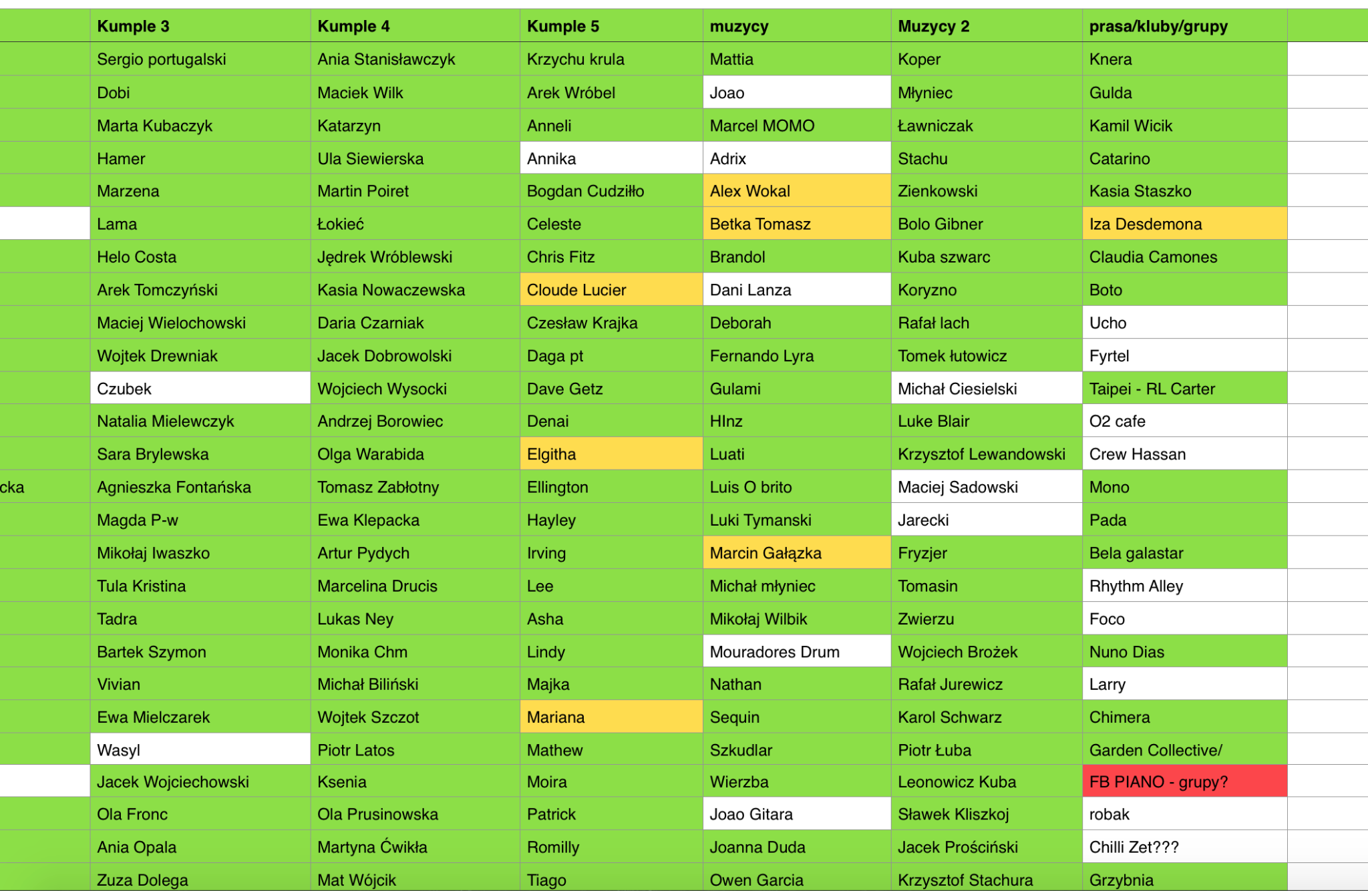
CROWDFUNDING
Preparation part 3 - timeline + contacts

Slide 13
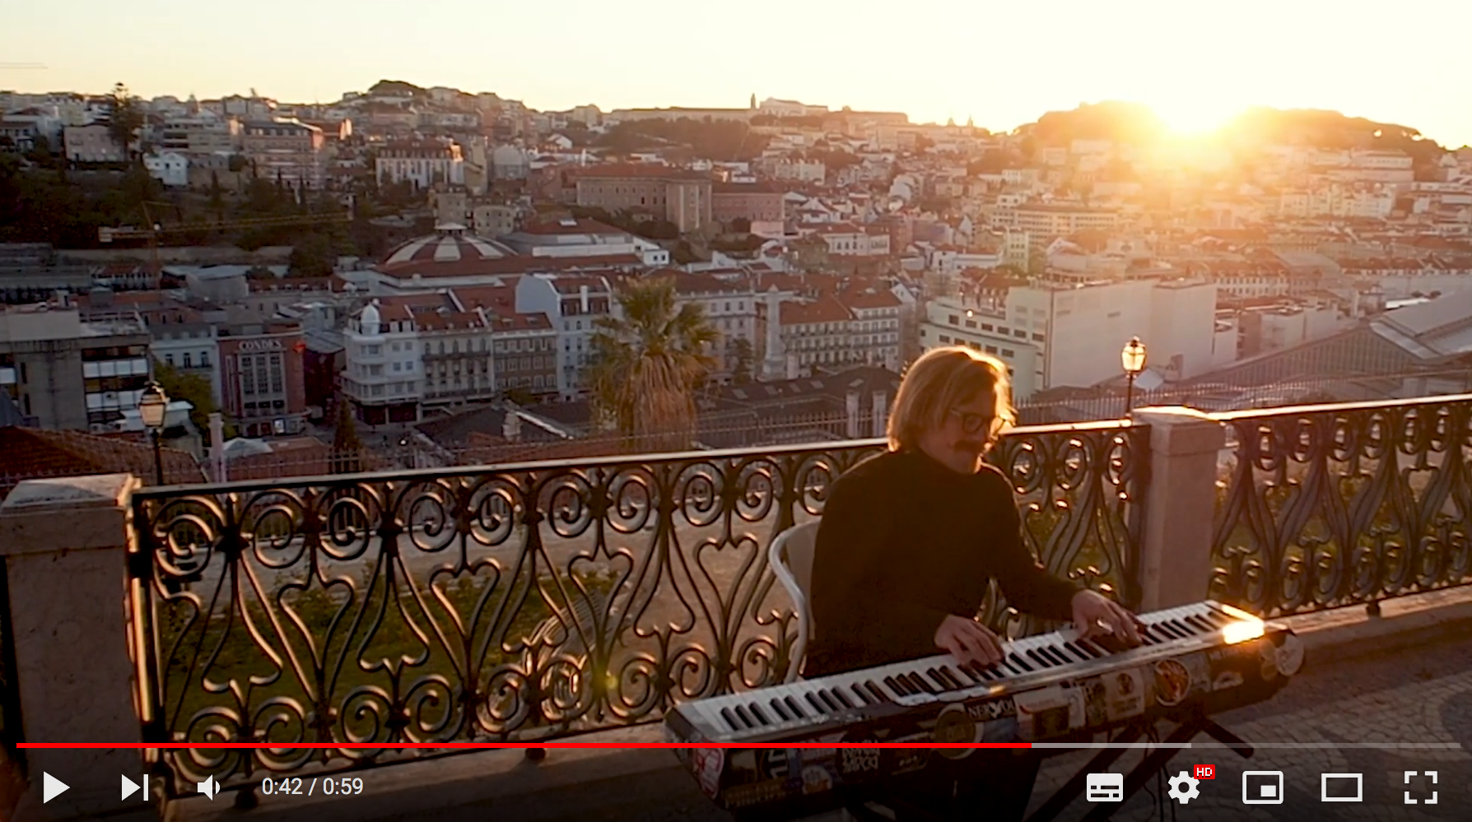
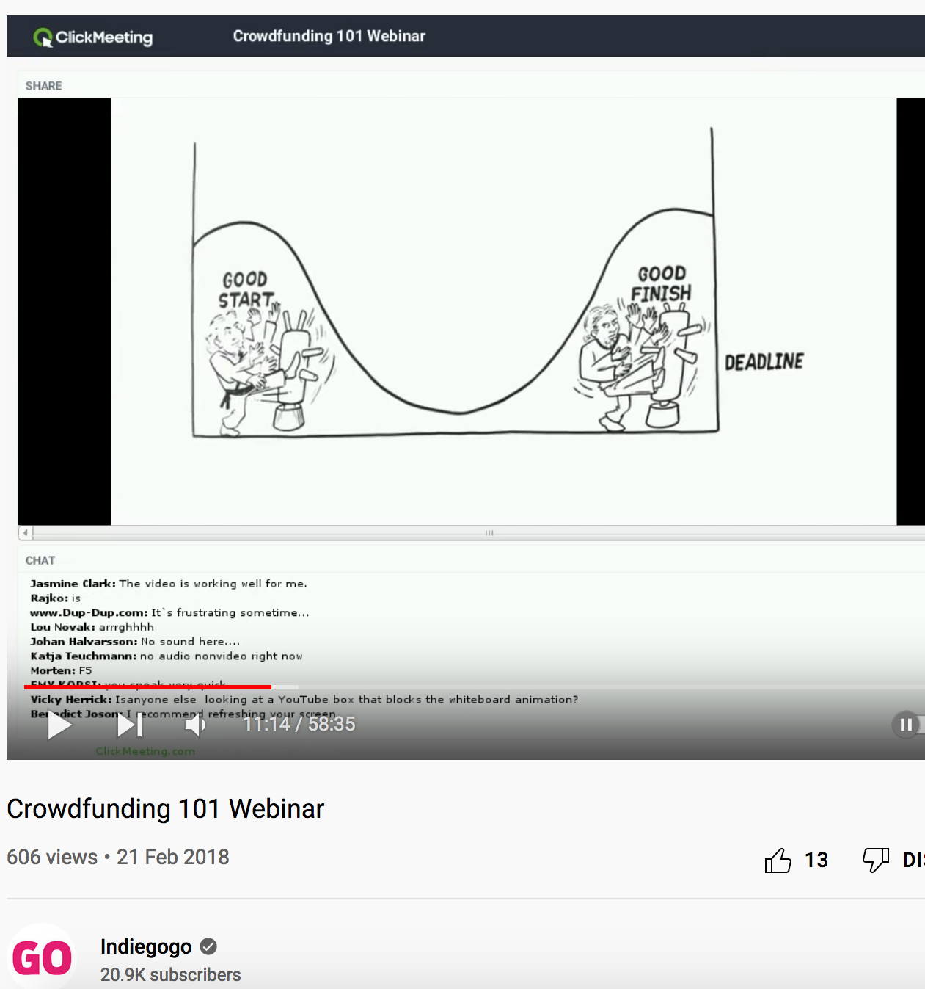
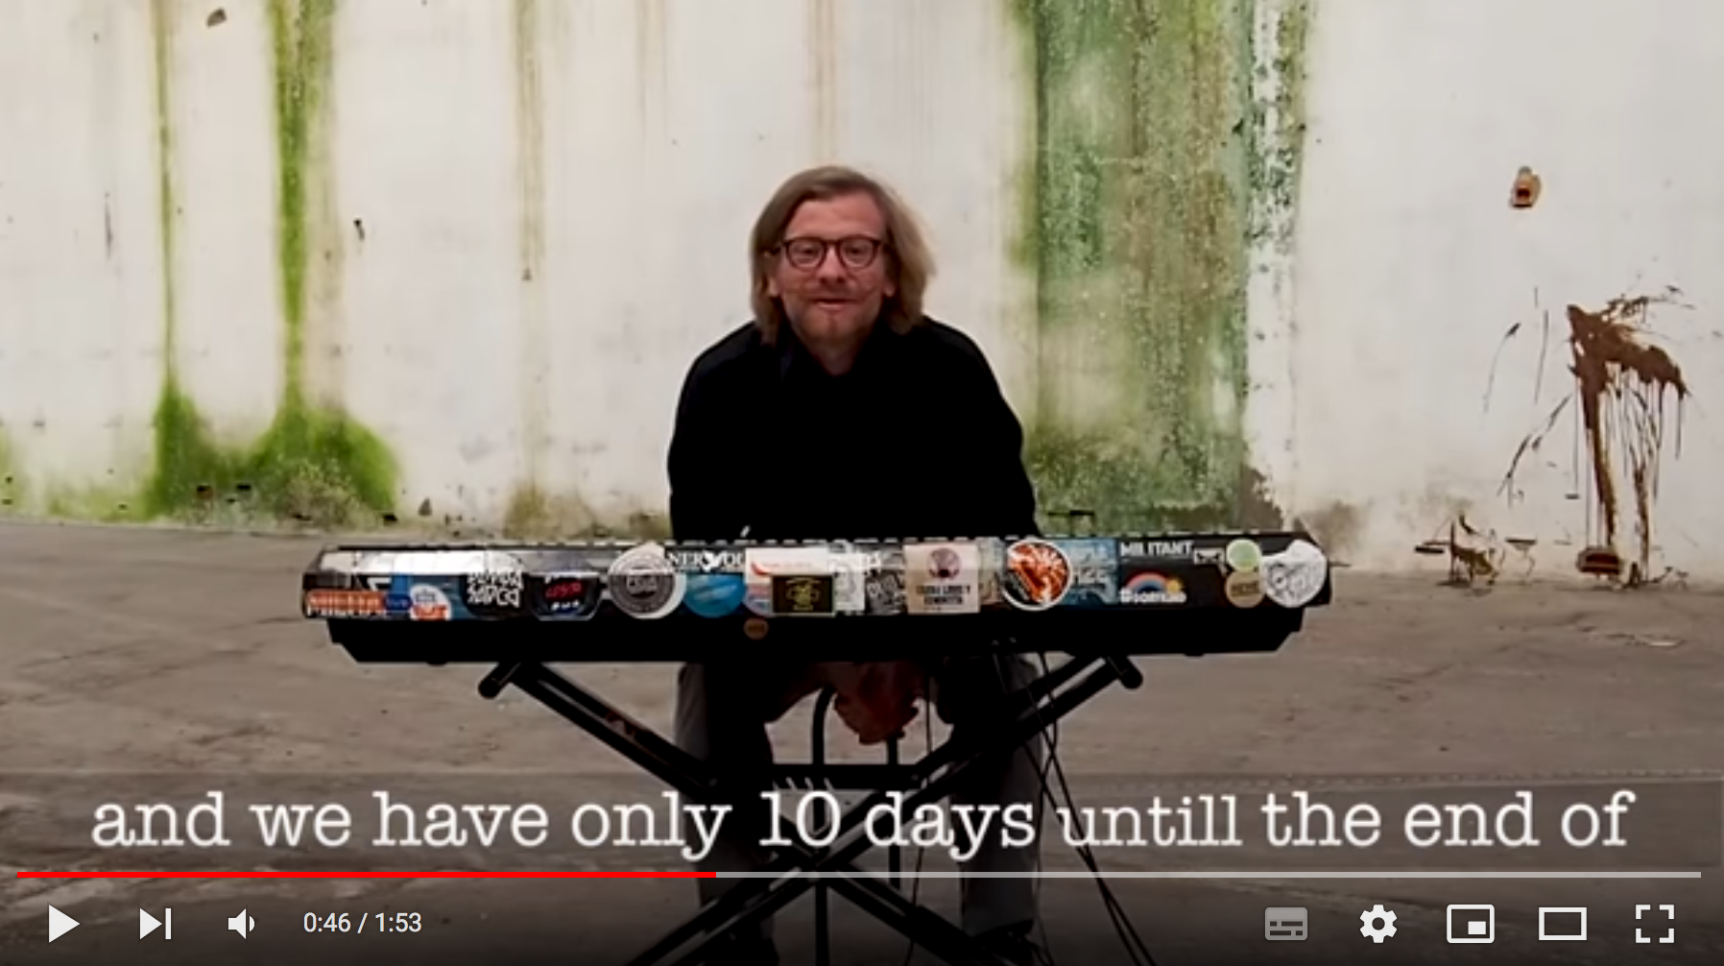
CROWDFUNDING
Campaign - updates, msg, phone, hard work etc

Slide 14
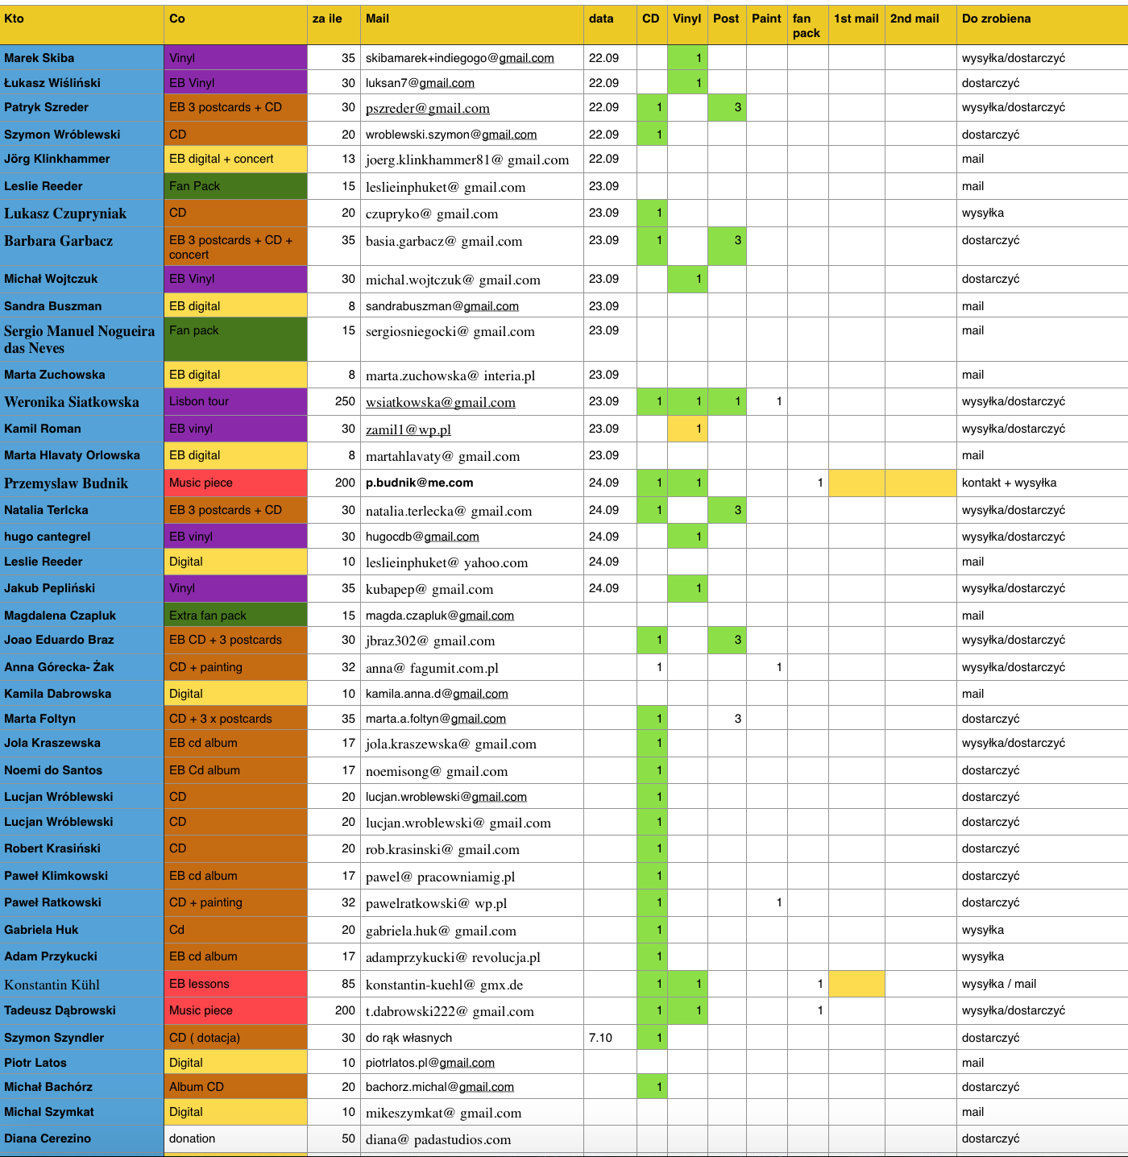
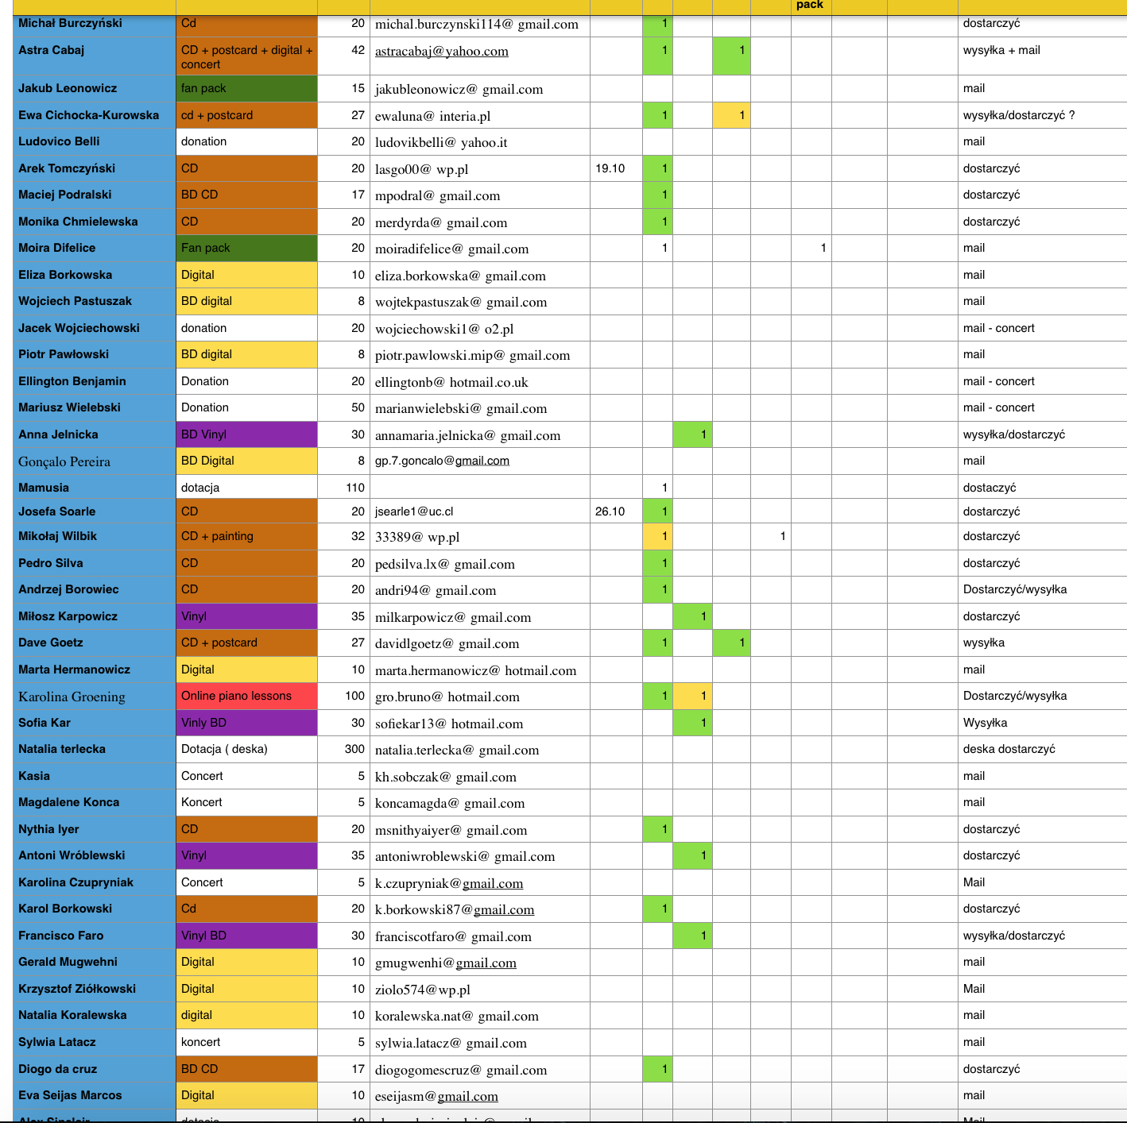
CROWDFUNDING
The end or beginning ? - sending perks, fanbase etc.

Slide 15
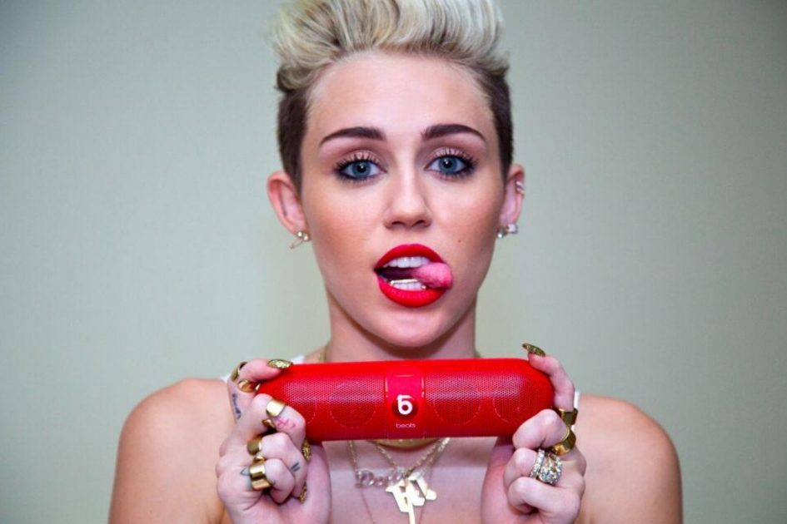
SPONSORSHIP (product placement)
An agreements between artist (or a band) and a commercial company.
Sponsors can offer an additional source of income to help you fund your music career, in exchange for you promoting or helping to sell their products or services to your audience.
Typical music sponsorship deals may involve endorsements of, for example:
beverages or food
music equipment
clothing brands

Slide 16
TYPES OF PRODUCT PLACEMENT:
The SHAMELESS TYPE:
Jennifer Lopez in her music video for ‘Papi’ is a great example of shamless/over-the top product placement. The video starts off with J-Lo brandishing her shiny Blackberry before trying to escape the hoards of men chasing after her, she then walks past TOUS jewellers, paces past a man holding a bottle of Crown Royal Whisky, passes another man using Planet Love Match on his laptop before jumping into a Fiat 500. Smooth.

Slide 17
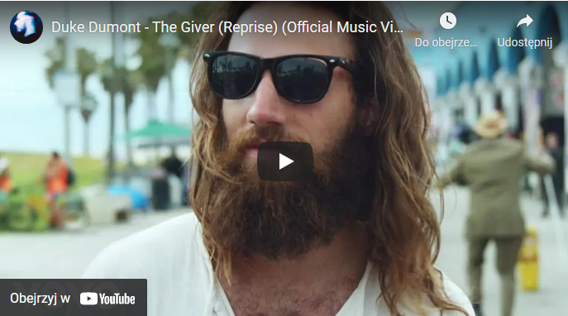
The SUBTLE type
As far as product placements in music videos are concerned, this example is pretty subtle. In the music video for ‘The Giver’, released by Duke Dumont in 2015, the camera momentarily pans in on a puma trainer at 2:47 for less than a second – it’s still enough to be noticeable (but subtle enough to get away with!).

Slide 18
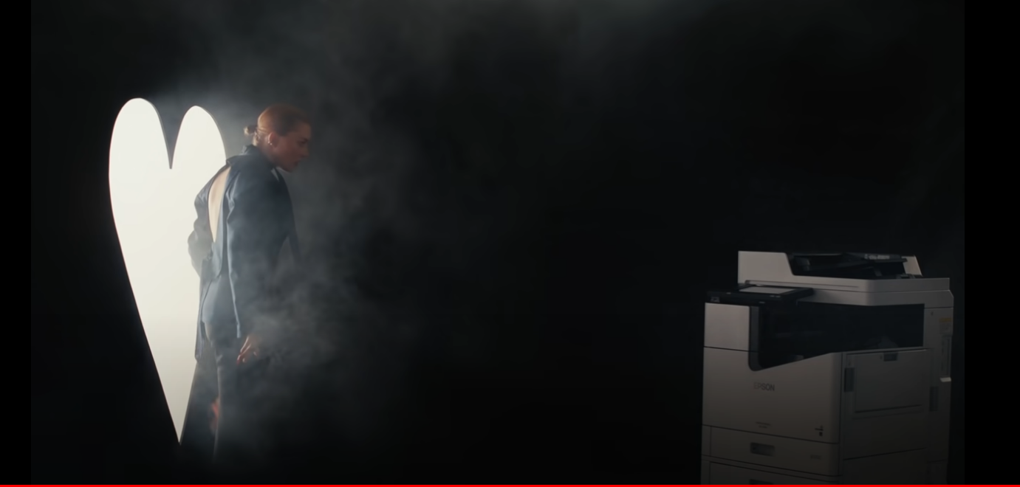
The CREATIVE type
Ofelia, polish alternative folk singer has recently done a video with my favorite product placement example up-to-date. She has partnered with printer brand EPSOM, and placed their product in her video. However, the product is not just there, randomly, but it plays an actual role in the script. The video tells a love story between her and the printer, and it’s very funny, cute, and not obnoxious at all. Although EPSOM does not seem to be a “sexy” brand at all, Ofelia and team used this partnership in a creative way, which not only added money to the video budget, but also added artistic value to the actual music video.

Slide 19
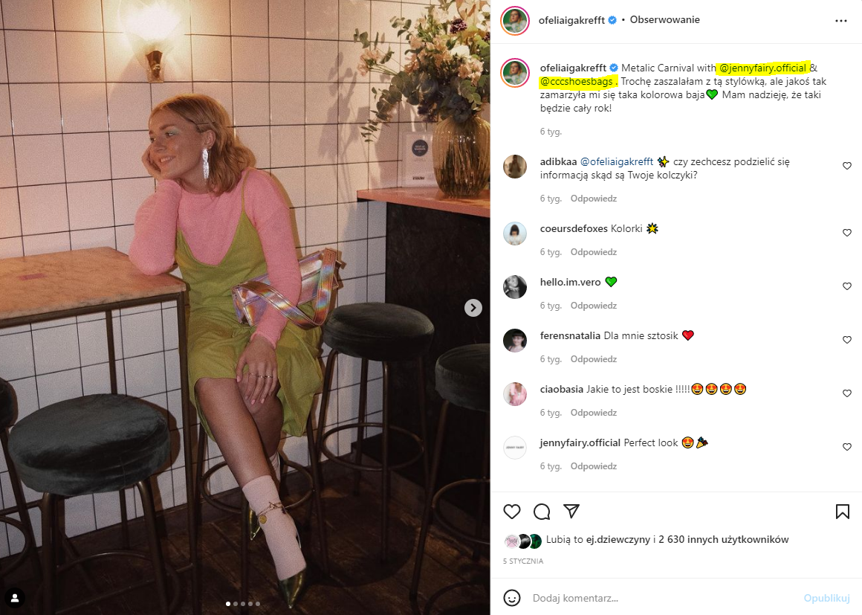
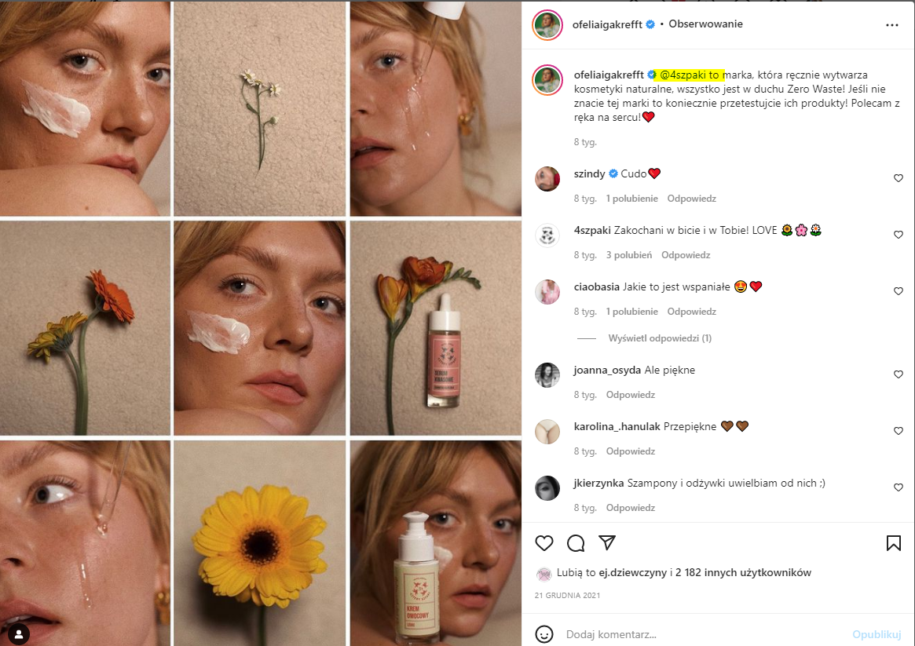
INSTAGRAM SPONSORED POSTS

Slide 20
WHAT DOES THE SPONSOR GET BACK?
Sponsors will generally only be interested in you if you can guarantee them exposure to a wide audience. If you haven't yet established your fan base, you may not be ready to pursue a sponsorship deal.
WHAT YOU CAN DO TO INCREASE YOUR CHANCES WHEN LOOKING FOR A SPONSOR?
Maximize Social Media.
Work on building and engaging that fanbase
Cold Calls. Don’t be afraid to pick up the phone to speak to someone in the local media industry about product placement opportunities.
Look for a niche.
Go local.

Slide 21
According to Influencer Agency, you might expect to be paid the following ranges based on follower count for 1 sponsored post on your social media:
$800-1500 for 25-50k followers
$1500-2000 for 50-100k followers
$2000-6000 for 100-150k followers
$6000-10000 for 250k-1m followers
$10000+ for 1M+ followers
Each country will have their own rates and standards.
E.g. (unofficially) I have just found out that the typical rate for someone like Ofelia (100 k followers on Instagram) is 5K PLN.

Slide 22
EXAMPLES OF BRANDS SUPPORTING THE MUSIC INDUSTRY
BACARDI AND MAJOR LAZER PARTNER IN CARIBBEAN SOUND OF RUM MUSIC INITIATIVE
The alliance gives both partners an opportunity to grow and introduce Caribbean music and culture to the world at large. “We’re happy to have found partners that are like-minded, that support us as much as we support them,” says Liz Walaszczyk, global head of music at Bacardi. “It is about creating new and interesting ways to embed the brand into the culture, and bring the roots of where we come from and where Major Lazer comes from, and what inspires both of us, to the world.
CONVERSE RUBBER TRACKS
Converse, with its extensive clout, reach and most importantly budget, set up recording studios in 18 different cities around the world, and offers free studio time to up-and-coming artists.
RED BULL:
Red Bull Music Academy
The Red Bull Music Academy (RBMA) is a world-traveling series of music workshops and festivals, founded in 1998 by Red Bull GmbH. The main five-week event is held in a different city each year. ... The Academy hosts additional music workshops and club nights and curates stages at festivals in around 60 countries worldwide.
Red Bull 64 Bars

Slide 23
CONCLUSIONS:
Don’t be afraid to look for money and partnerships with companies. This is a standard practice in the industry. Even the most earning musicians do everything they can not to use their own money to fund their projects.
Authenticity is key when it comes to brands collaborating with musicians. Don’t be like J. Lo or DJ Khalid XD if you care about your relationship with your fans/reputation
Remember that the music industry is a business and an entire ecosystem, and finding other companies to work with and mutually support/leverage each other’s reach should be a top priority on your agenda
Even if you are a niche artist, without much of a following, you can look for small, local businesses that are willing to grow with you, and partner with them. Chances are you will have no competition, and you might build something long term.

Slide 24
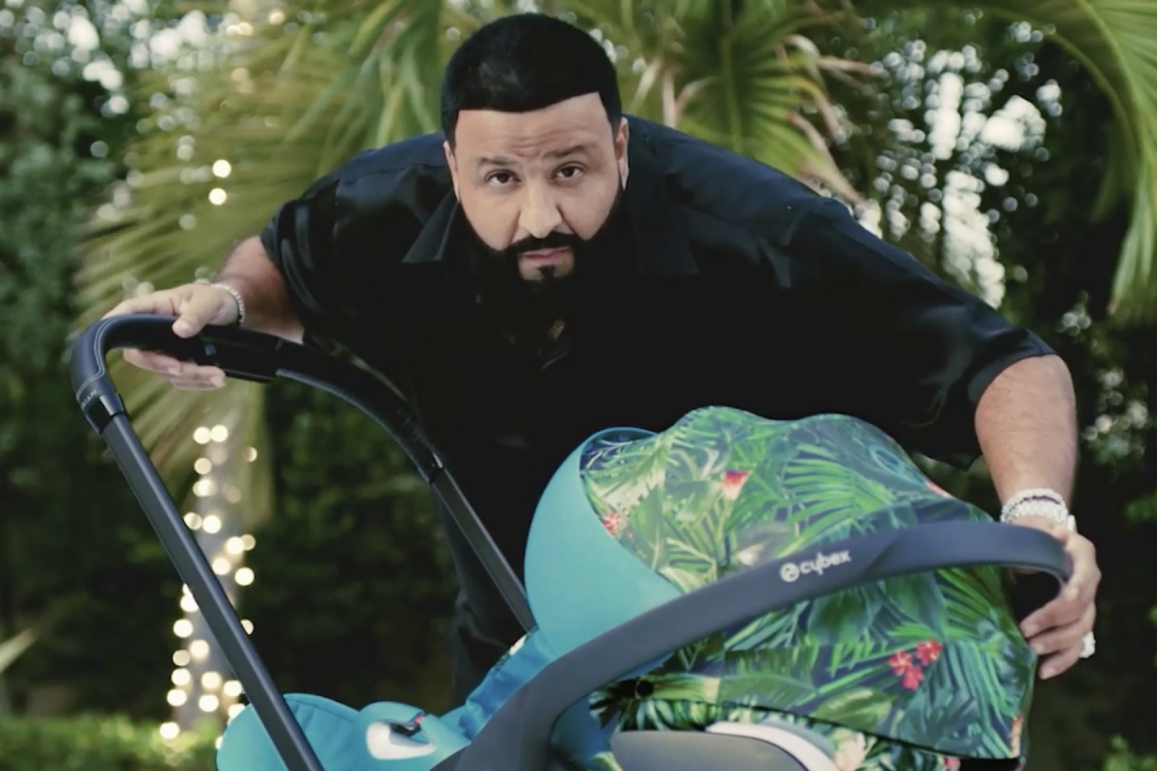
THANKS!!!

